Slide 1



Cybersecurity Data Analysis
Robert Quaye & Sabrina Barrile
Notes:
Sabrina

Slide 2
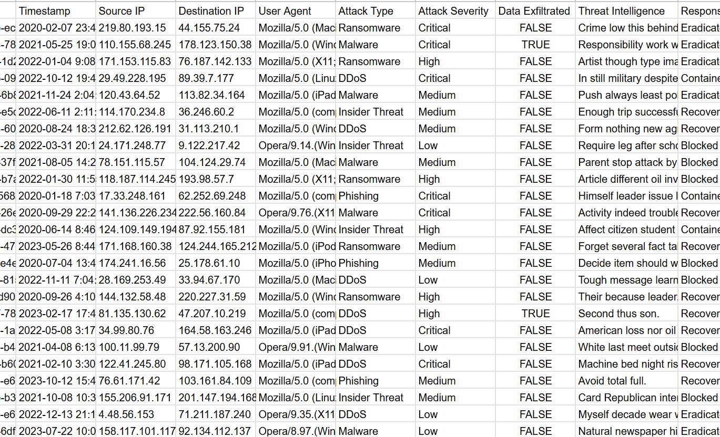
Our Dataset
From Kaggle
Columns include Event ID, Timestamp, Source IP, Destination IP, User Agent, Attack Type, Attack Severity, Data Exfiltrated, Threat Intelligence, and Response Action
20,000 rows
Notes:
sabrina

Slide 3

Data
Preparation
Reduced data size
Checked for missing values
Removed unnecessary columns
Converted columns from nominal and ordinal data to numerical
Notes:
Robert

Slide 4
Research Questions
What’s the most common attack type/severity?
What’s the trend in attacks per month?
Can we predict the likelihood of a response action per attack severity & attack type?
Notes:
Robert

Slide 5
Types
Ransomware
DDOS
Insider Threat
Phishing
Malware (everything else)
Notes:
Robert

Slide 6
What’s the most common attack type/severity? (methodology)
Countplot graph
Seaborn
Notes:
We imported the Seaborn library, and the countplot function was used to visualize the distribution of the data based on the "Attack Type" column in the dataset. This provided a clear representation of the frequency of each attack type, helping to identify prevalent threats. Similarly, the same approach was applied to the "Attack Severity" column, creating another visualization to highlight the distribution of attack severities within the dataset.

Slide 7
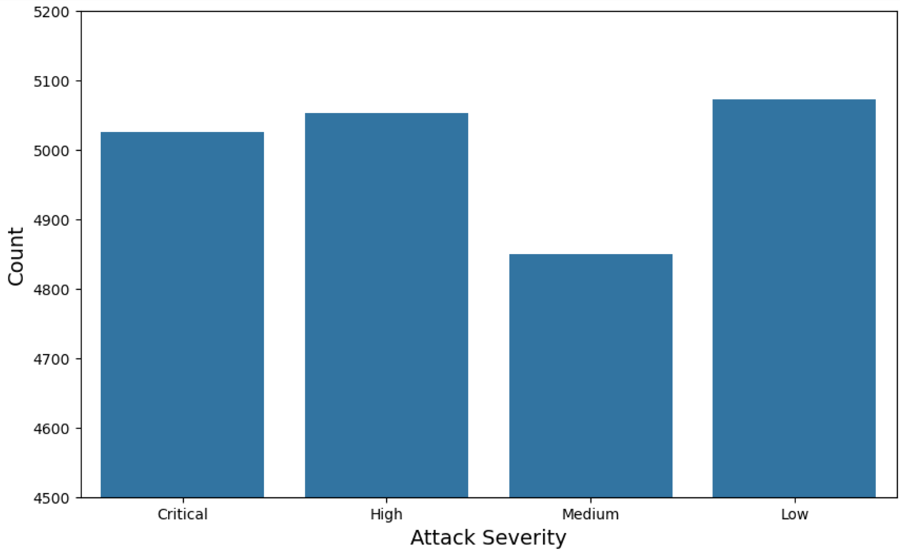
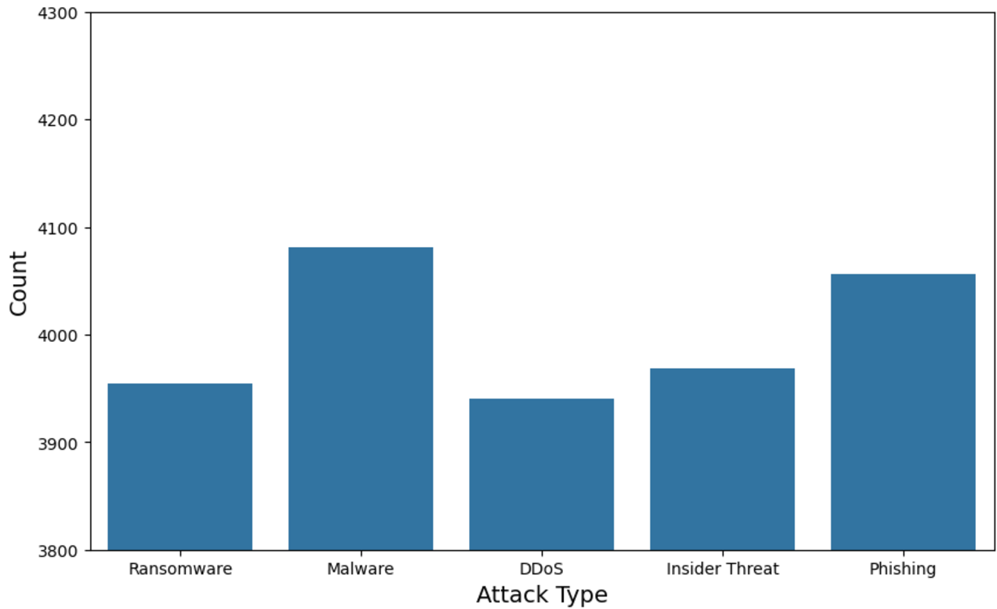
What’s the most common attack severity/type? (results)
Notes:
Robert

Slide 8
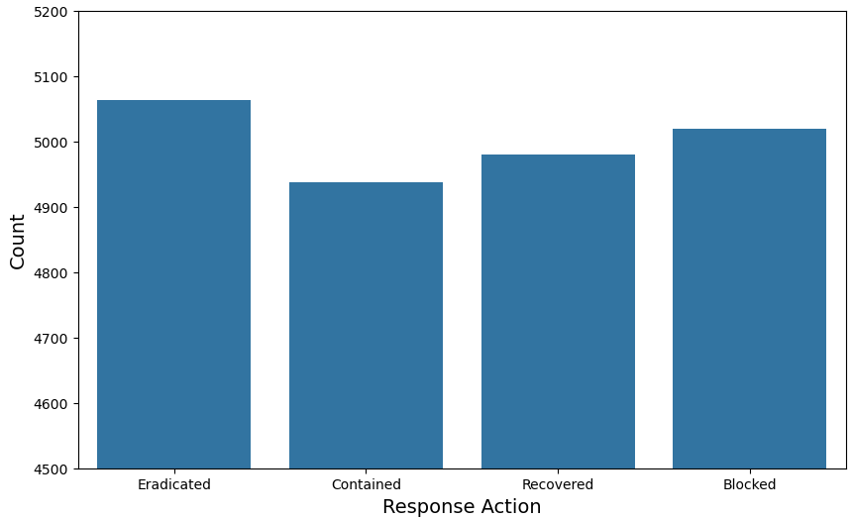
Response Action
Notes:
Robert

Slide 9
What’s the trend in attacks per month? (methodology)
Trend-line graph
Notes:
The Matplotlib library was imported and utilized to create a line plot visualizing the trend of monthly attack counts from 2020 to 2024. This plot illustrates changes in the frequency of attacks over time, resulting in a clear view of patterns, seasonal variations, or potential spikes in activity during specific periods.
Sabrina

Slide 10
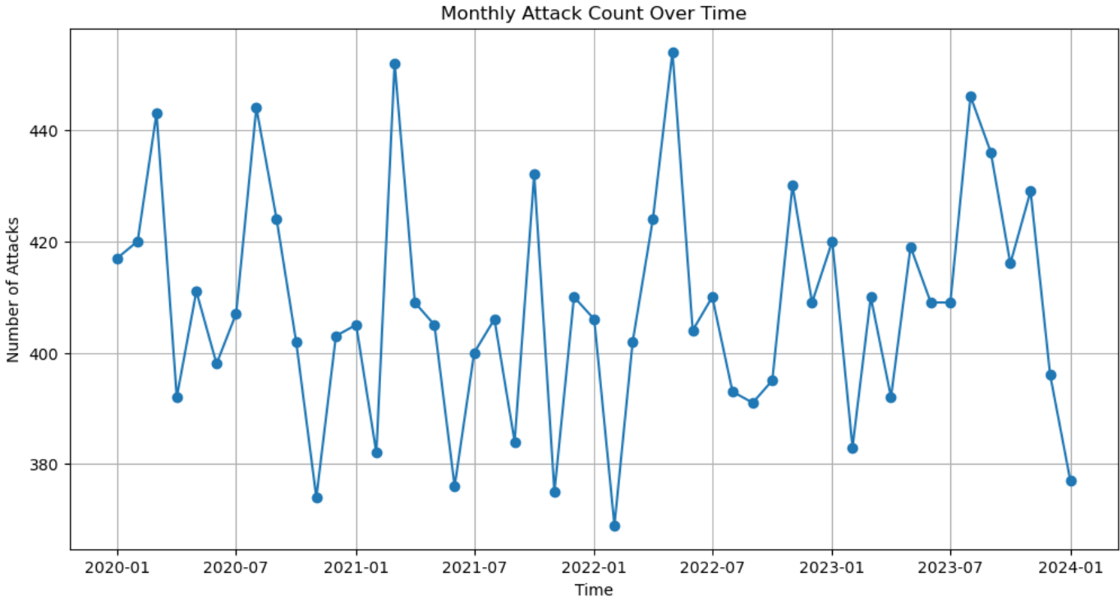
What’s the trend in attacks per month? (results)
Notes:
Robert

Slide 11
Can we predict the likelihood of a response action per attack severity/type? (methodology)
KNN
Decision Tree
Notes:
The K-Nearest Neighbors (KNN) and Decision Tree algorithms were used to predict the likelihood of a response action based on attack severity and attack type. Features such as severity levels and types of attacks were transformed into numerical values, allowing KNN and Decision Tree to analyze the relationships in the dataset. These models was trained and tested to determine how accurately it could classify response actions for given scenarios, resulting in useful insights for decision making in the cyber world.
Sabrina

Slide 12
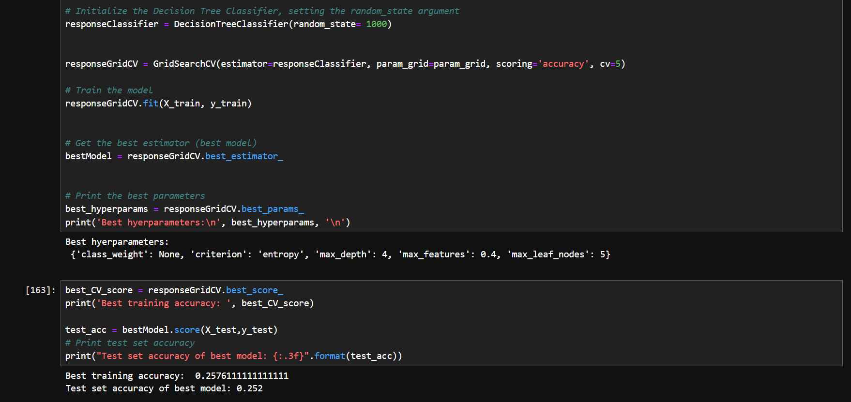
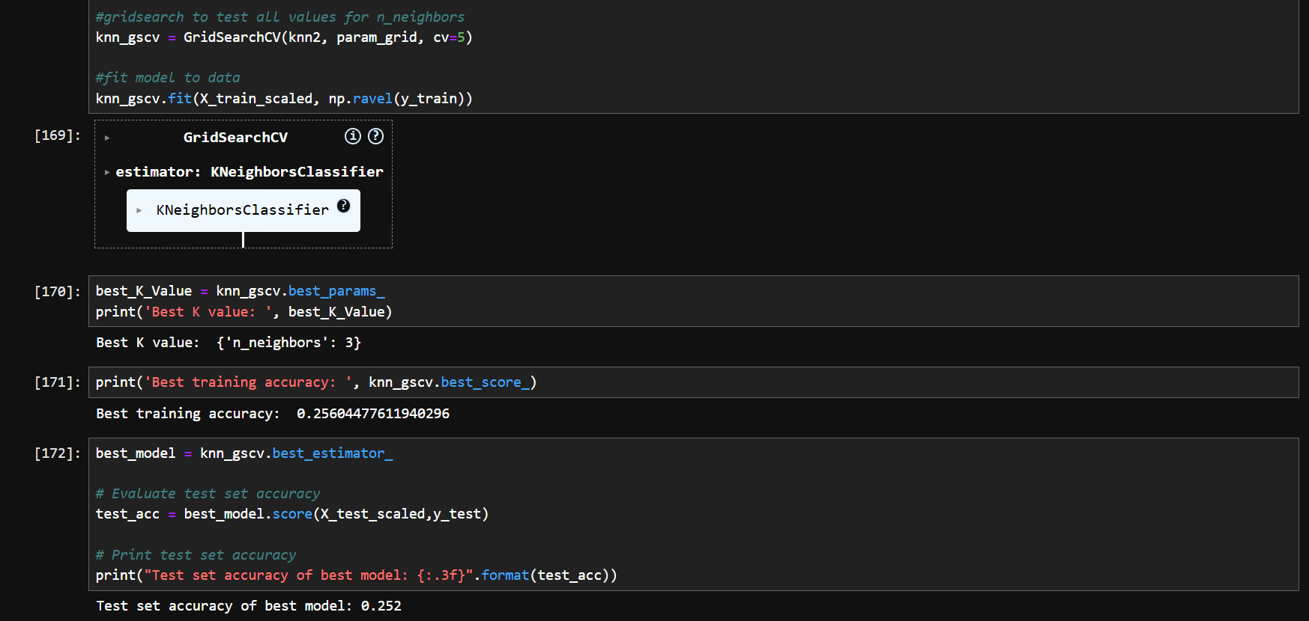
Can we predict the likelihood of a response action per attack severity/type? (results)
Notes:
Robert

Slide 13
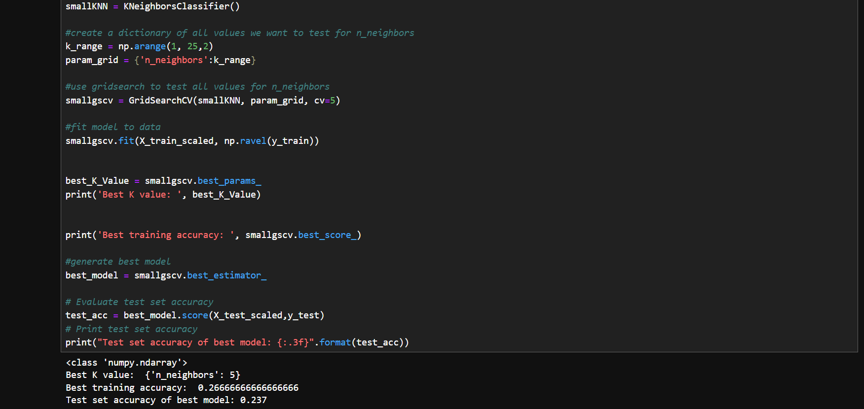
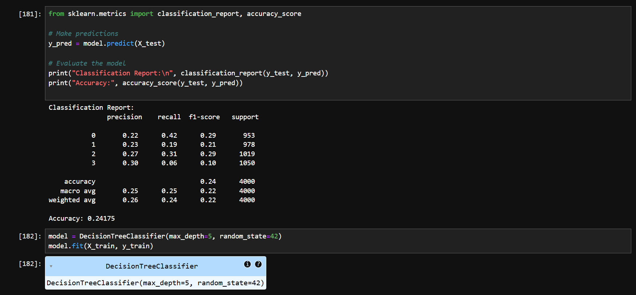
Can we predict the likelihood of a response action per attack severity/type? (results)
Notes:
Robert

Slide 14
Research Questions We Didn’t Use
Are certain source IP or destination IP combinations repeatedly involved in Critical attacks?
Is there a relationship between the severity of the attack and the source IP address?
Is there a relationship between the severity of the attack and the destination IP address?
Do attacks originating from internal source IPs differ significantly in severity or outcome compared to external source IPs?
Notes:
Sabrina

Slide 15
Challenges/Future Work
Coming up with questions
Each IP was unique
Conversion of data types to numeric
  Mods wouldn’t accept strings or float
Locate IP addresses
Notes:
Sabrina - future work
Robert - challenges

Slide 16
Questions?
Notes:
Sabrina

Slide 17
References
https://www.kaggle.com/datasets/hassaneskikri/ai-enhanced-cybersecurity-events-dataset?resource=download
https://scikit-learn.org/stable/modules/generated/sklearn.tree.DecisionTreeClassifier.html

